Slide 1



The logistics of short supply chains
Funded by the European Union. The views and statements expressed herein reflect the views of the author(s) and do not necessarily reflect the official position of the European Union or the Education, Audiovisual and Culture Executive Agency (EACEA). Neither the European Union nor the EACEA can be held responsible for them. Project number: 2024-1-RO01-KA210-ADU-000254716

Slide 2





LEAP partnership:
Presented by:
Péter Bajor, Csilla Fejes

Slide 3
Contents
01.
03.
The basics of logistics processes
Value stream analysis and losses
02.
04.
05.
Identifying logistics problems and challenges
Logistics risks and their management
Toolkit and awareness

Slide 4
1. The basics of logistics processes – Efficiency and planning in short supply chains based on the 9M principle

Slide 5

What makes short supply chains special?
Few players in the chain
A (more) direct relationship with customers
Shared values
Producers take on more roles – logistics, procurement, marketing, quality assurance
Personal responsibility

Slide 6

What does a
logistics specialist do?

Slide 7

Logistics activities
Procurement
Production planning
Distribution
Customer service
Inventory management
Warehousing
Logistics IT
Packaging
Reverse logistics

Slide 8



In the right place
9M
principle
At the right time
The right product

Slide 9



In the right quantity
9M
principle
At the right cost
In the right quality

Slide 10


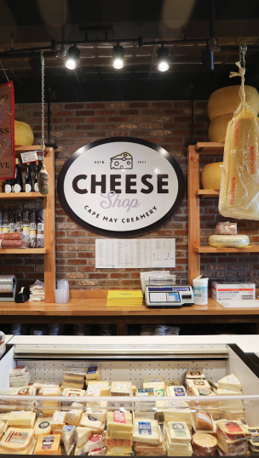
Provided with the right information
9M
principle
Using the right energy
For the right customer

Slide 11


TASK 1: WHAT DOES COMPLIANCE MEAN? APPLYING THE 9M LOGISTICS PRINCIPLE USING THE EXAMPLE OF A CHEESE-MAKING FARM
Work together to create a mind map whose branches collect the elements/characteristics related to the 9M principle of logistics in the context of a cheese-making business!

Slide 12
TASK 2: MY SALES CHANNELS
Describe the sales channels you use and explain your choice for each one!
If you would like to try out a new channel, please describe that too!

Slide 13
2. Methods for identifying logistical problems and challenges

Slide 14
What recurring problems might we encounter?
High delivery costs
Late deliveries
Deteriorating or inconsistent product quality
Customer complaints

Slide 15
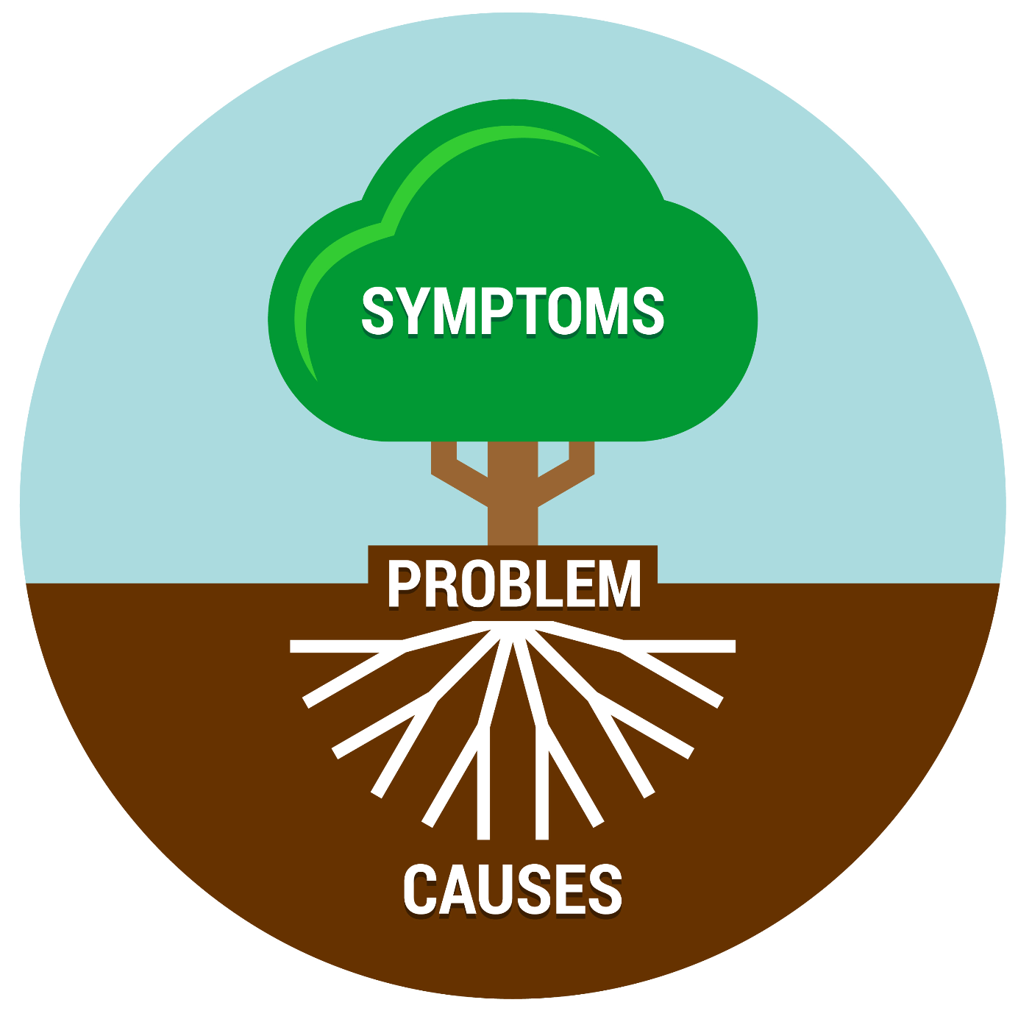
What might be the reasons? And what might be the root of the problem?

Slide 16
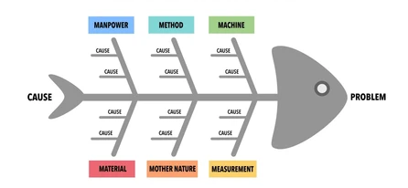
One possible analytical tool: the fishbone diagram
Man: of human origin
Method: applied method
Machine: caused by the machine used
Material: caused by the material used
Mother nature: caused by natural factors
Measurement: error in measurement

Slide 17
How do we use it?
The aim is not to list one specific reason for each sub-branch
The main aim is to analise and examine problems at a systemic level
When solving problems, we should address not just the symptoms, but the underlying causes

Slide 18
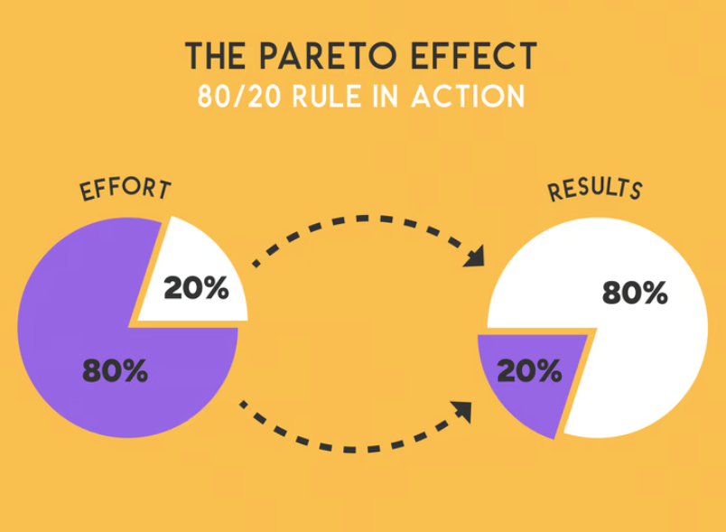
Let’s focus on what matters:
the Pareto principle
the vast majority of results are due to a few factors
most problems are caused by a few key factors
let’s identify these and concentrate on them!
Source: Pinterest

Slide 19
How do we use it?
Define the area under investigation!
Collect data on the area (e.g. costs, faults, time factors)!
Sort the data!
Create a chart!
Identify the most important factors!
Let’s find solutions to the critical factors!

Slide 20
TASK 3: FISHBONE DIAGRAM ANALYSIS
Work together to conduct a fishbone diagram analysis of the high number of customer complaints received by a producer offering a weekly vegetable box subscription, which relate to the quality of the products received by consumers! What might be the possible causes?

Slide 21
TASK 4: PARETO ANALYSIS
Identify which of your activities you consider necessary to perform a Pareto analysis on, and explain why!

Slide 22
3. Value stream analysis and reducing losses in logistics processes

Slide 23

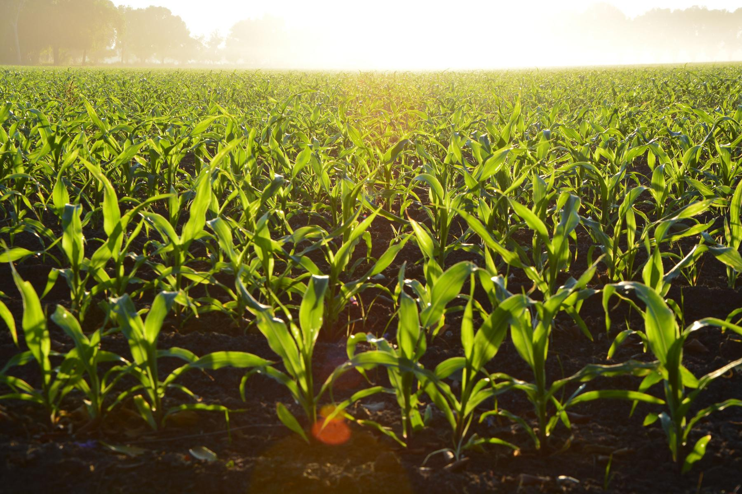

Let’s analyse our processes!
Value-adding process: an activity that creates added value for the customer, and for which the customer is willing to pay
Non-value-adding process: does not add to the product but requires resources

Slide 24

An example from a vegetable farmer
Harvest
Packaging
Transport
Sorting
Storage
Sales
Characters: farmer, staff
Cast: farmer, staff
People involved: farmer, graphic designer, printers, marketing
Characters: farmer, warehouse owner
Characters: farmer, driver
Characters: farmer, family members, shopkeepers

Slide 25
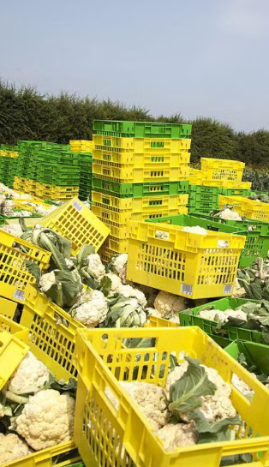


Losses resulting from unnecessary stockpiling
loss
The 7+1
logistics
loss
Overproduction
Losses resulting from unnecessary transport

Slide 26


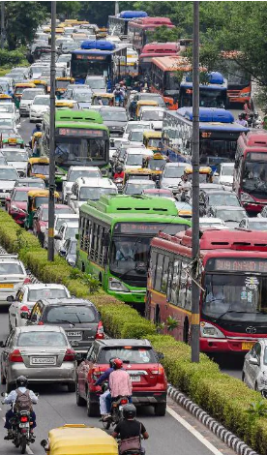
Waiting-related
loss
The 7+1
logistics
loss
Losses resulting from errors and defects
Loss resulting from unnecessary movement

Slide 27


Neglected talent and ideas
The 7+1
logistics
loss
Loss caused by overproducing

Slide 28
TASK 5: VALUE STREAM
On the attached worksheet, you will see the participants in a value stream analysis for a family-run beekeeping business. Link the related participants, indicate the direction of the value, material, product and information flows between them, and list possible sources of loss for each process element!

Slide 29
4. Logistics risks and their management within SFSC

Slide 30
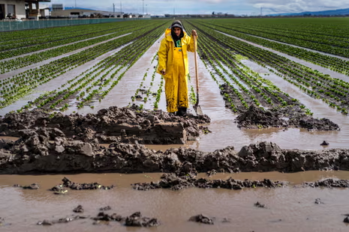
What risks do we face?
Delivery delays
Stock shortages
Unexpected costs
Customer communication issues
Variable product quality
Weather risks
Health risks, etc.

Slide 31
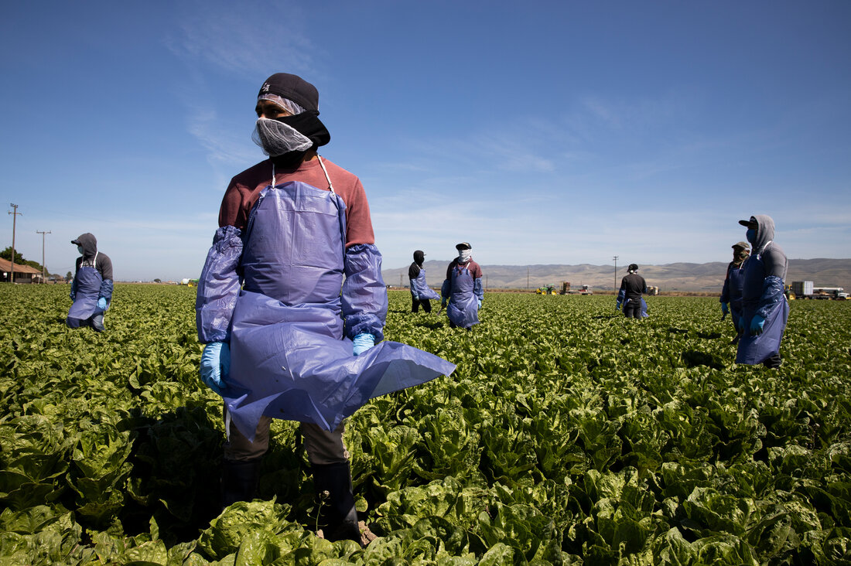
What happens, if we don’t treat them?
Loss of income
Dissatisfied customers
Business insecurity
Health, public health consequences
Bad reputation

Slide 32
The key: let’s be prepared!
Identify the possible risks
Analyze the possible causes and effects
Develop a solution /a plan to avoid risks

Slide 33

A possible tool:
FMEA analysis
This method helps identify errors in advance, determine their impact, severity, and likelihood of occurrence.

Slide 34
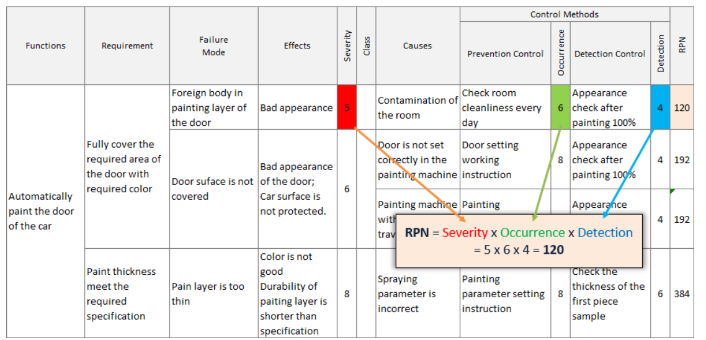
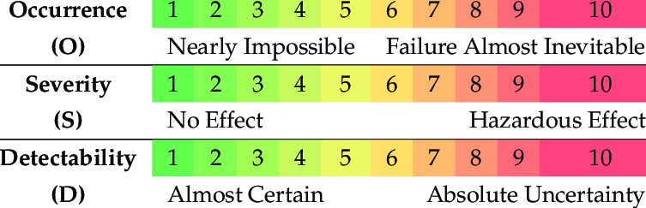
How do we use it?
Identify the logistics processes
Determine the potential errors
Analyse the severity of the errors(S), occurance (O), detectability (D)
Calculate the risk priority number(RPN) - the higher the level, the more urgent it is to address the issue

Slide 35
TASK 6: RISK ASSESSMENT
A small-scale producer of cream cheese and sandwich spreads is conducting an FMEA analysis to prepare as effectively as possible for the risks associated with its perishable products during market days. Help them evaluate the results in the table below and develop recommendations for addressing the three most high-risk nonconformities!

Slide 36
5. Logistics Tools and Locistics Awareness

Slide 37
Let’s stand consciously by our processes!
Keep track of expenses, shipments, and revenue!
Ask for reviews from partners and customers!
Plan and use the proven methods!
Focus on soulutions instead of problems!

Slide 38

What advantages can be achieved by this?
Cost reduction
More effective time management
Growing customer satisfaction
More predictable incomes
Smaller environmental impact
Risk reduction
Increased competitiveness

Slide 39
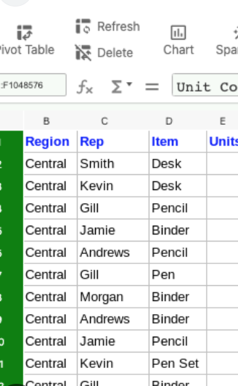
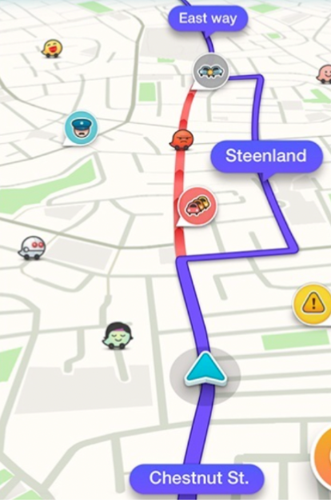
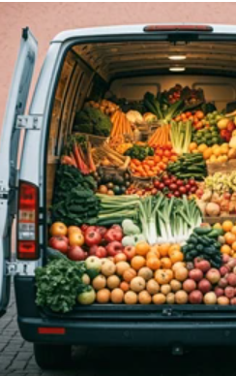
Cooperations, joint delivery
A few easy-to-integrate
tools
Electronic or paper records
Route planning
Google Maps, Waze, Via Michelin, Deliveo
Excel, Word, specific softwares

Slide 40
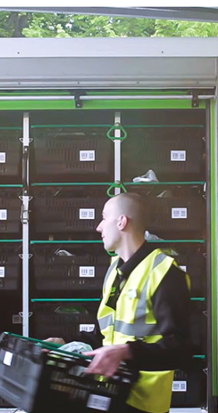
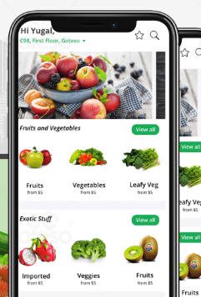
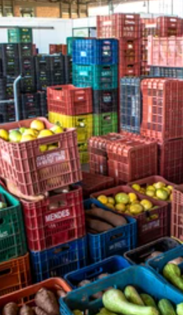
Sharing storage capacity
Google Forms, Google Sheets,
A few easy-to-integrate
tools
Collecting
Pre-orders
Parcel lockers, pickup points
Google Forms, Google Sheets, webpage, Facebook groups, Messenger

Slide 41
TASK 7: IMPLEMENTATION
Select two logistics tools from those listed in this chapter that are easy to implement (for example: inventory management system, route planning, pre-order system)!
●Describe how you would apply these in practice!
●What benefits would these tools bring to your operations?

Slide 42
THANK YOU FOR YOUR ATTENTION!
Funded by the European Union. The views and statements expressed herein reflect the views of the author(s) and do not necessarily reflect the official position of the European Union or the Education, Audiovisual and Culture Executive Agency (EACEA). Neither the European Union nor the EACEA can be held responsible for them.

