Slide 1
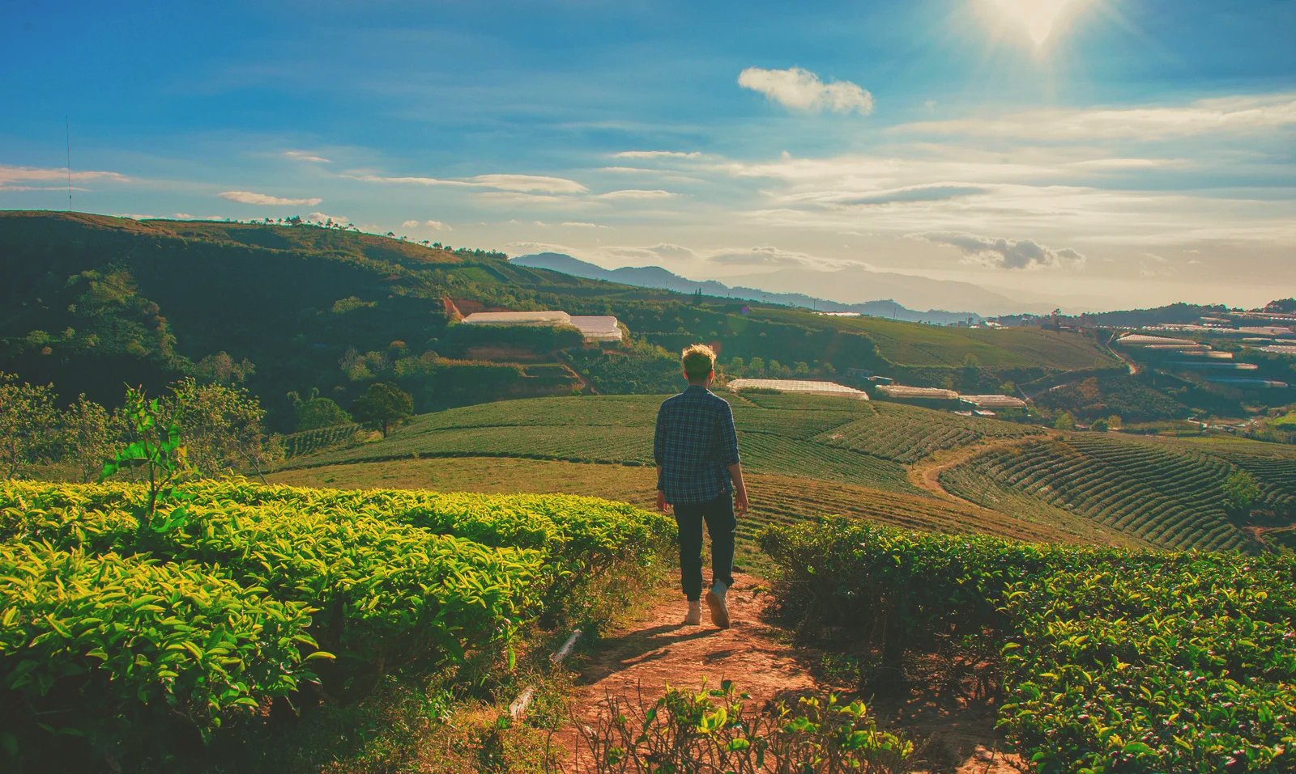



Short supply chains and environmental sustainability
Co-funded by the European Union. The views and statements expressed herein reflect the views of the author(s) and do not necessarily reflect the official position of the European Union or the Education, Audiovisual and Culture Executive Agency (EACEA). Neither the European Union nor the EACEA can be held responsible for them. Project number: 2024-1-RO01-KA210-ADU000254716

Slide 2





LEAP partnership:
Presented by:
ANNA PAYR

Slide 3
Contents
01.
03.
Sustainable management
and packaging
Sustainability goals
02.
04.
Footprints
(environmental impacts)
Certification schemes

Slide 4
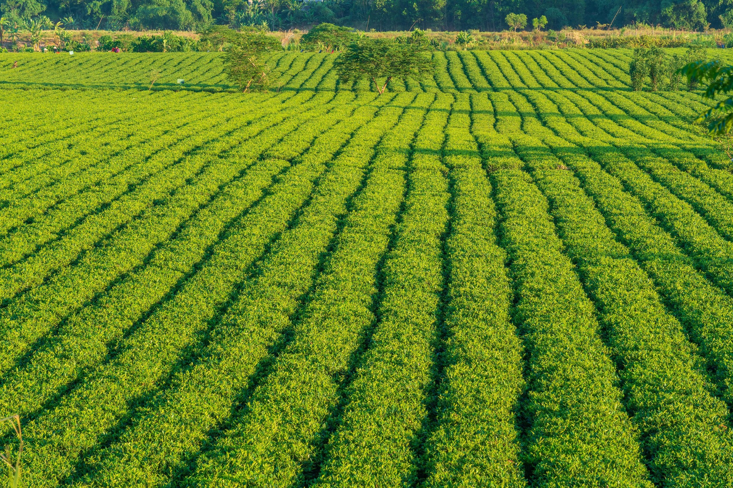
SFSC channels
Local farmers’ market
Fairs, festivals
Pick-your-own
Personalised home delivery
Farm shop
Shopping community
Box scheme
Community-supported agriculture
Catering
Agritourism, guest dining
and experiential programmes
Farm shop
Vending machine
Restaurant
Online sales
Farm shop

Slide 5
Task: What environmental and sustainability criteria
does the selected SFSC channel meet?

Slide 6
1. Sustainability goals
Sustainability =
planning our actions today
so as not to destroy tomorrow’s opportunities

Slide 7
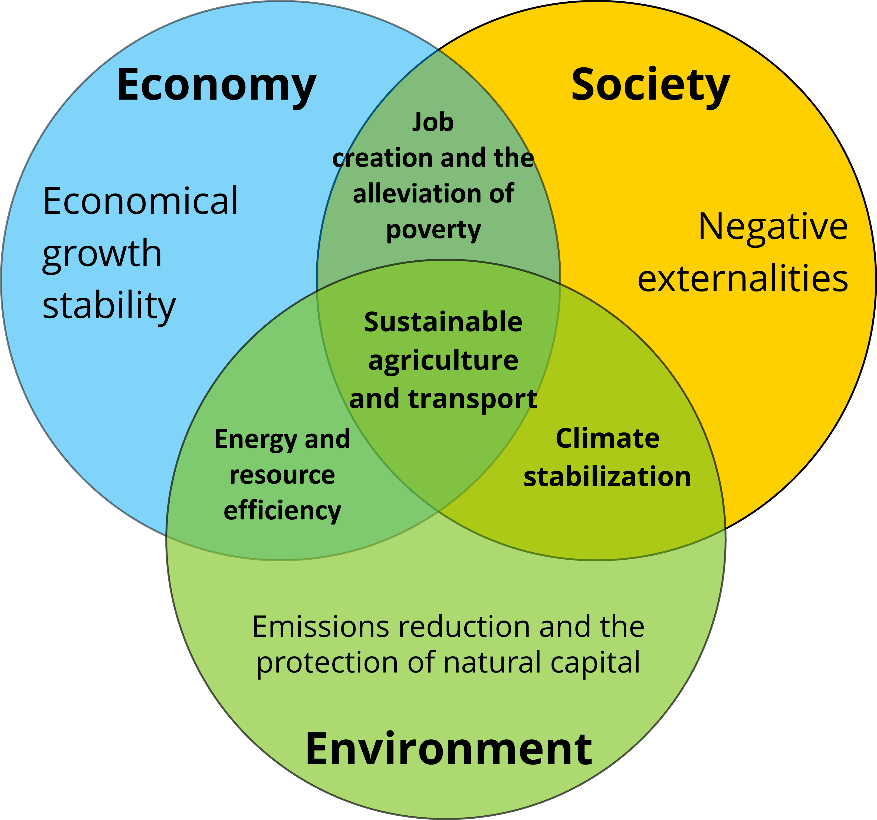

The pillars of sustainability:
Economic sustainability
Social sustainability
Environmental sustainability

Slide 8

The pillars of sustainability
Economic sustainability

Slide 9
Task:
Which of the Sustainable Development Goals
does the previously selected SFSC channel correspond to?

Slide 10

Task:
What are the short-term, practical benefits of striving for sustainability and environmental protection?
increased consumer confidence and demand
cost savings
Compliance with tender requirements
compliance with regulatory requirements
Environmentally conscious → a discerning and loyal customer base

Slide 11
2. Footprints
What is the environmental impact of how food ends up on our plates?
Direct and indirect impacts
The importance of life cycle assessment
Carbon footprint
Water footprint
Ecological footprint

Slide 12
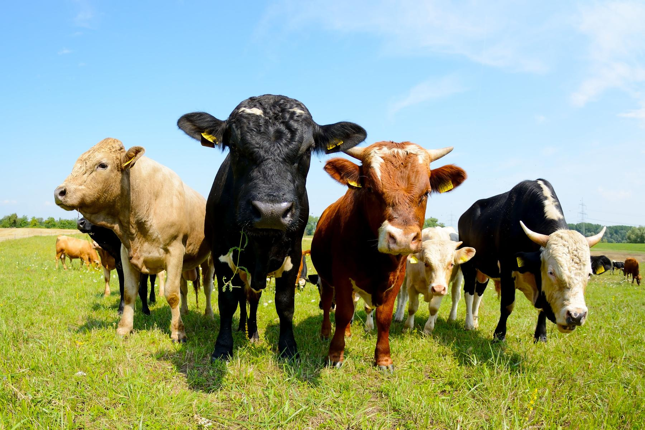
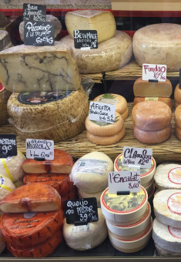
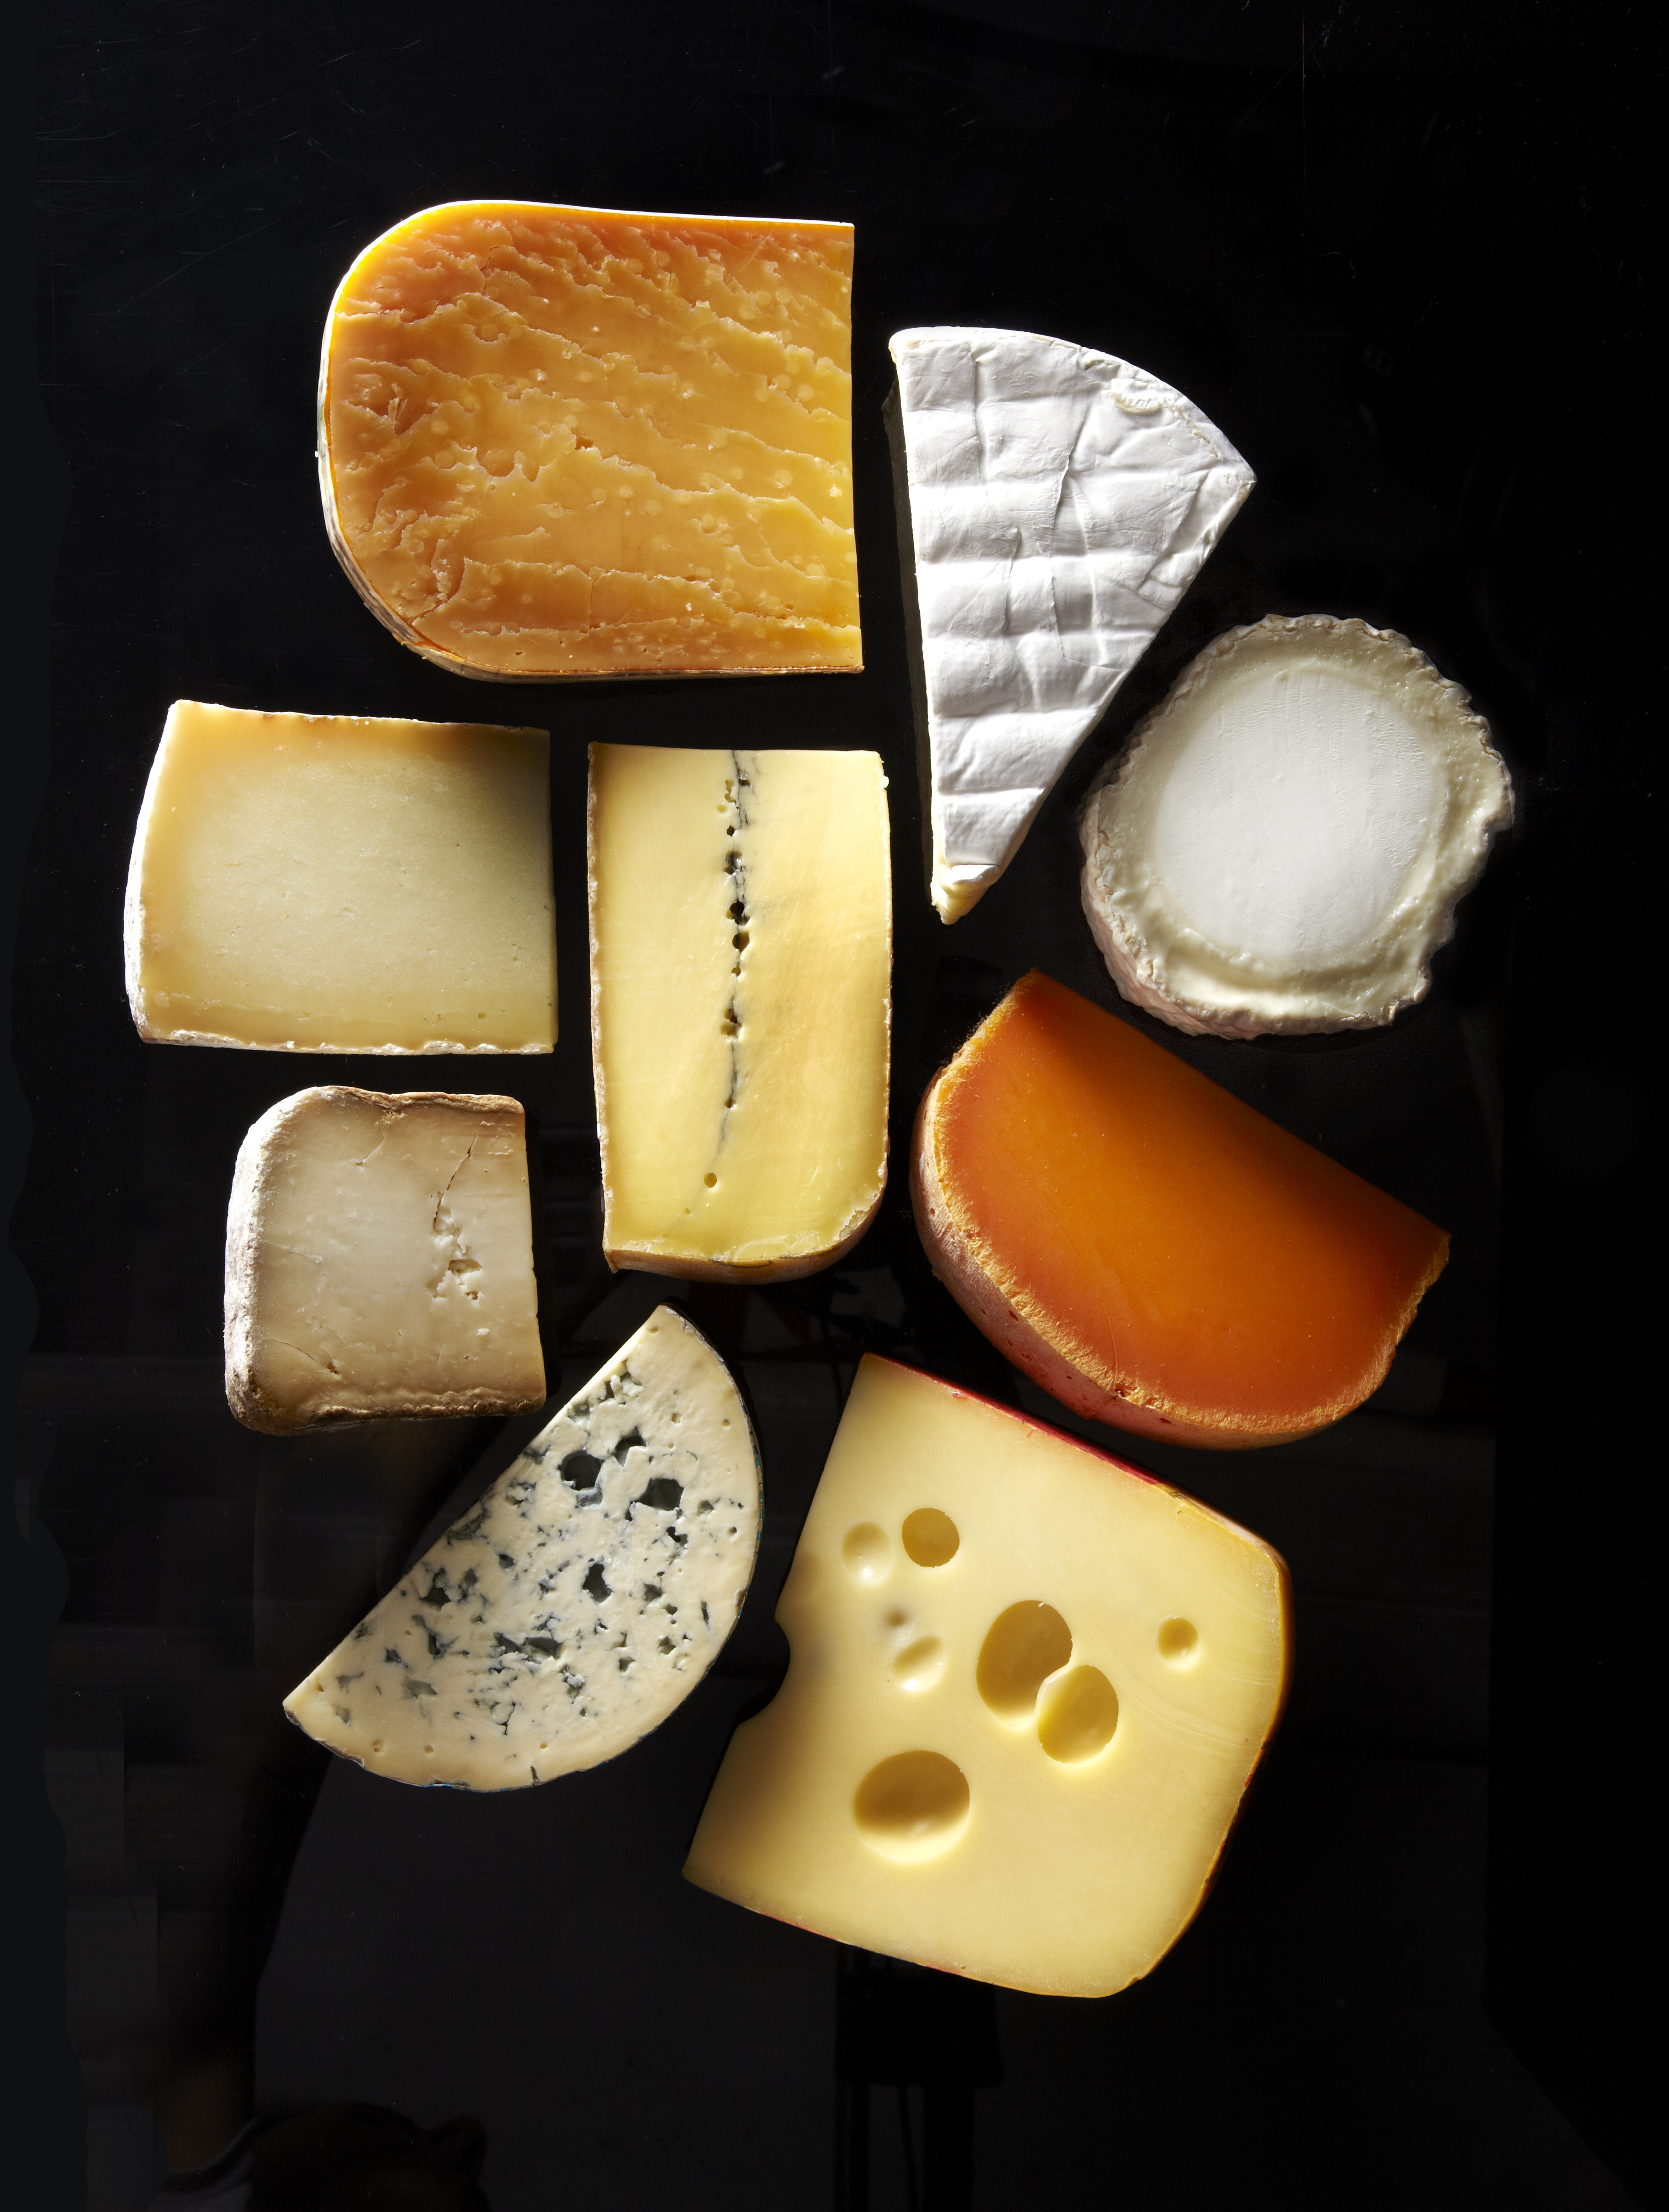
Food
life cycle
2/1
Processing
Production – farming
Packaging

Slide 13

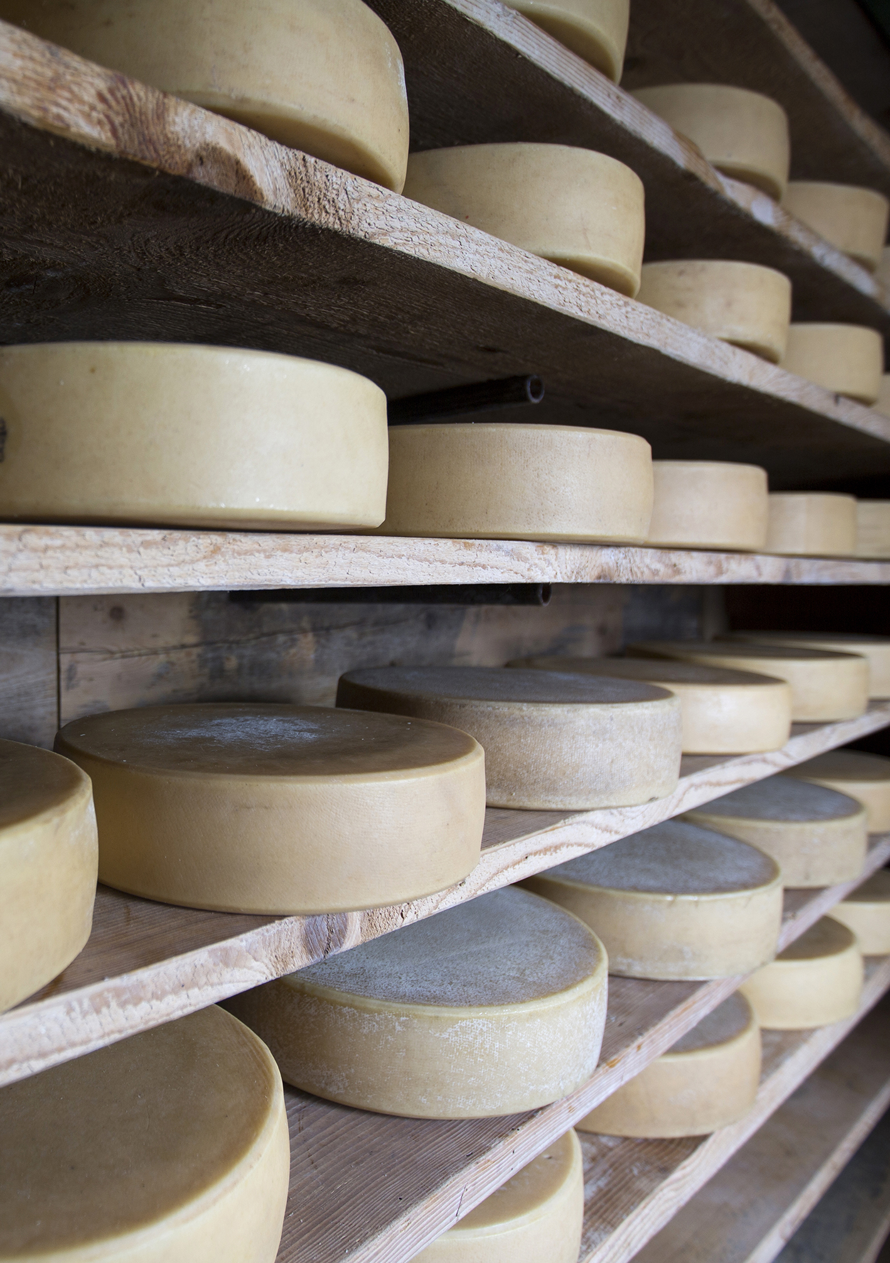
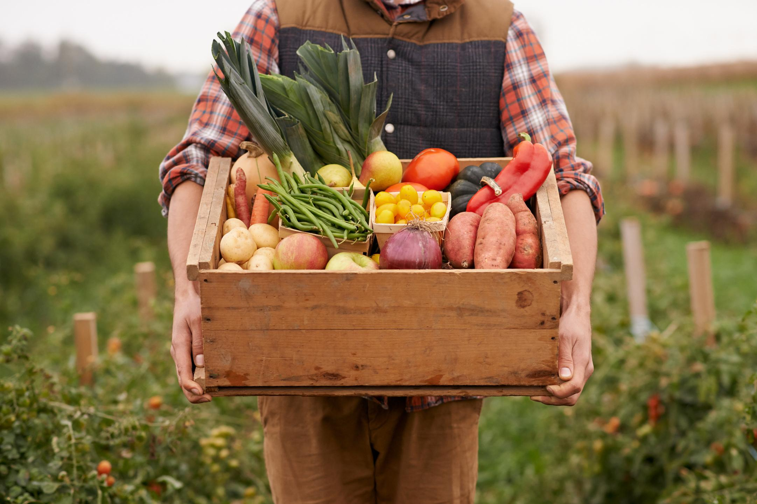
Storage, warehousing
Food
Life cycle
2/2
Transport
Waste management

Slide 14
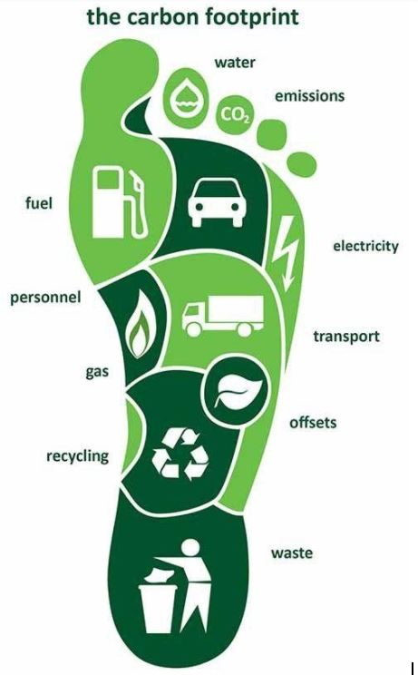
Carbon footprint
Objective: to understand the environmental impact of the activity
Quantity of greenhouse gases emitted (CO2, methane, N2O)
Unit of measurement: CO2e (carbon dioxide equivalent)
Directly or indirectly during the activity
Changes can be monitored through regular measurement

Slide 15
Reducing the carbon footprint
Reducing energy wastage, energy efficiency
Use of renewable energy sources
Offsetting emissions – ensuring carbon sequestration: using trees (plants) and topsoil

Slide 16


Water footprint
Blue water: surface and groundwater
for human activities, e.g. irrigation, manufacturing
Green water: water in the soil
used by plants
Grey water
water required to dilute contaminated water

Slide 17
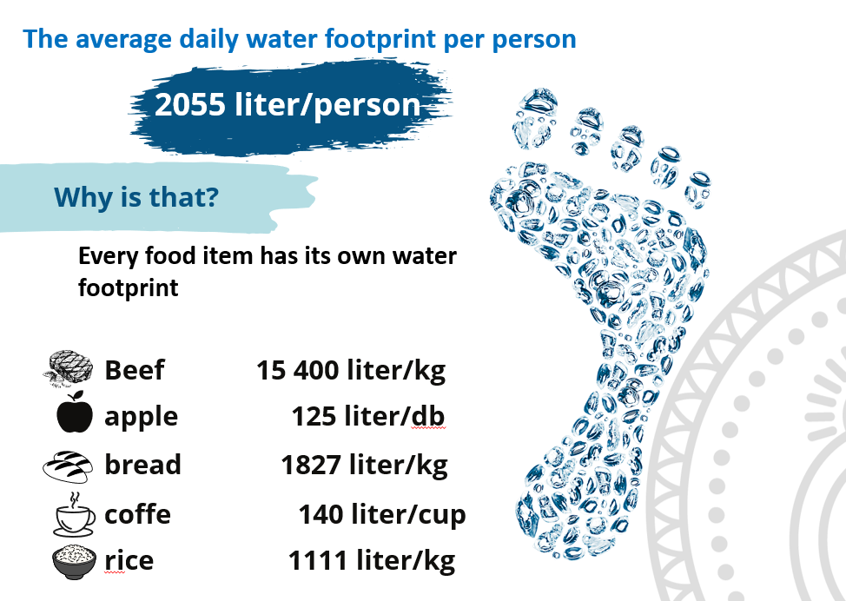
Water
footprint
EXAMPLES:

Slide 18
Reducing the water footprint
Reducing water demand
Water retention in the soil
Reducing food waste
Water recycling
Reducing water pollution

Slide 19
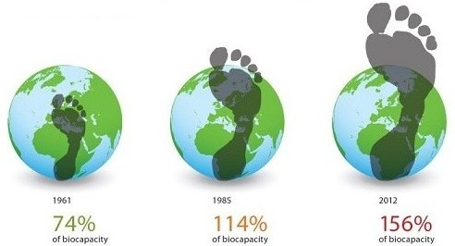
The ecological footprint
Comprehensive indicator – the amount of biologically productive land required to meet the needs of a given activity and to offset its impacts
Unit of measurement: global hectares (gha)
For the production of consumption, energy requirements, etc.
To absorb emissions

Slide 20
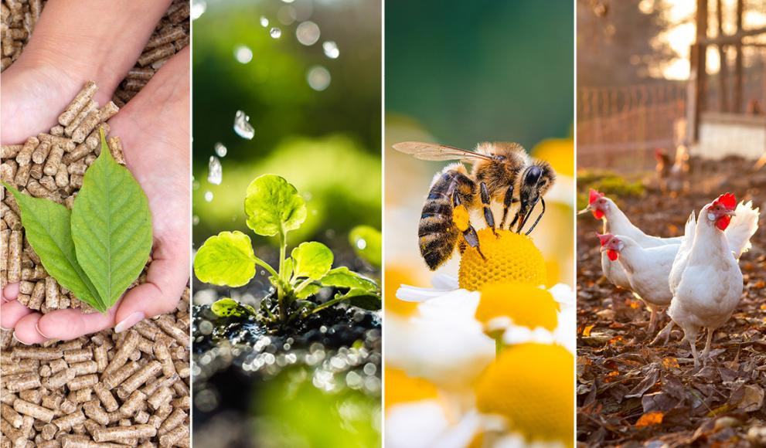
3. Sustainable farming
Crop production
Livestock farming

Slide 21
Sustainable crop production
Replacing or reducing the use of fertilisers and chemical plant protection products:
Biological plant protection
Nutrient-rich soil (high organic matter and microelement content, good structure)
Good variety selection: use of resistant varieties
Appropriate timing
Use of crop rotation
This is also crucial for soil health – healthy plants need healthy soil, and healthy soil needs healthy vegetation!

Slide 22
Sustainable crop production 2.
Factors to consider when selecting varieties:
Use of resistant and hardy varieties
Use of landraces adapted to local conditions (collected seed, grafting, budding)
Own propagation, seed saving: the variety is adapted to the farm’s conditions and requirements
Other considerations: e.g. energy-efficient storage
Cultivation of old, forgotten, less demanding plants, e.g. drought-tolerant varieties
Use of multiple varieties, experimentation → getting to know the varieties + reducing risk
Varieties with higher nutritional value and better flavour → customer satisfaction and health

Slide 23
Sustainable crop production 3.
Creating complex habitats:
Biodiversity in terms of both species and varieties
Preserving and creating natural habitats on the farm that are suited to local conditions – as many types as possible and over as large an area as possible, but at least in patches → the habitat’s self-regulating capacity begins to function → improved plant health and fertility (pollination)
Soil water management and the farm’s microclimate improve significantly, making it more resilient to extreme weather conditions
E.g.: brushwood piles, dead trees, wildflower meadows or strips, medicinal and aromatic plants, ponds, wooded areas, forest strips, shrub strips (of local evergreen and flowering varieties), bee pastures

Slide 24
Sustainable livestock farming 1.
Keeping native animal breeds:
Greater resilience
Require less care and are suitable for (more) extensive husbandry
Suitable for maintaining natural habitats (e.g. grazing)
Preservation of biodiversity
Support for local values and traditions, use of local knowledge
High-quality products!

Slide 25
Sustainable animal husbandry 2.
Animal welfare:
Meeting basic needs
Preventing boredom, injury and disease
Providing a suitable environment
Expression of natural behaviour
Preventing stress and fear
Animals are sentient beings; animal welfare concerns not only their physical but also their emotional well-being!

Slide 26
Sustainable livestock farming 3.
Feeding:
Food produced locally (or nearby) where possible
Food production must also be sustainable – NO GMOs!
Food should not compete with food intended for human consumption
Good practices: grazing, by-products, food waste, utilisation of surplus
Proper feeding → better digestion → less methane, e.g. in the case of cattle
A balanced, healthy diet
→ more resilient animals
→ more efficient production
→ lower veterinary and medication costs

Slide 27
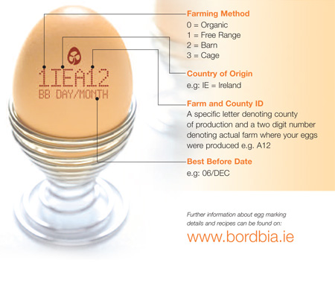

Slide 28
Housing methods
2 – Alternative housing
(deep litter)
0 – Organic farming
04.
1 - Free-range
3 – Cage rearing

Slide 29
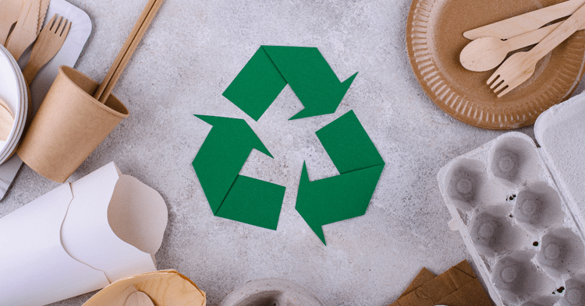
3. Sustainable packaging
What does
separately collectable
recyclable
reusable
compostable mean?

Slide 30
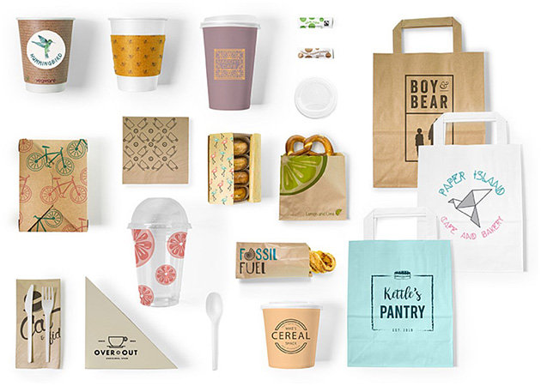
What is the difference?
biodegradable
compostable
(breaks down in 12 weeks)
Where can it be composted?
at home
under industrial conditions

Slide 31
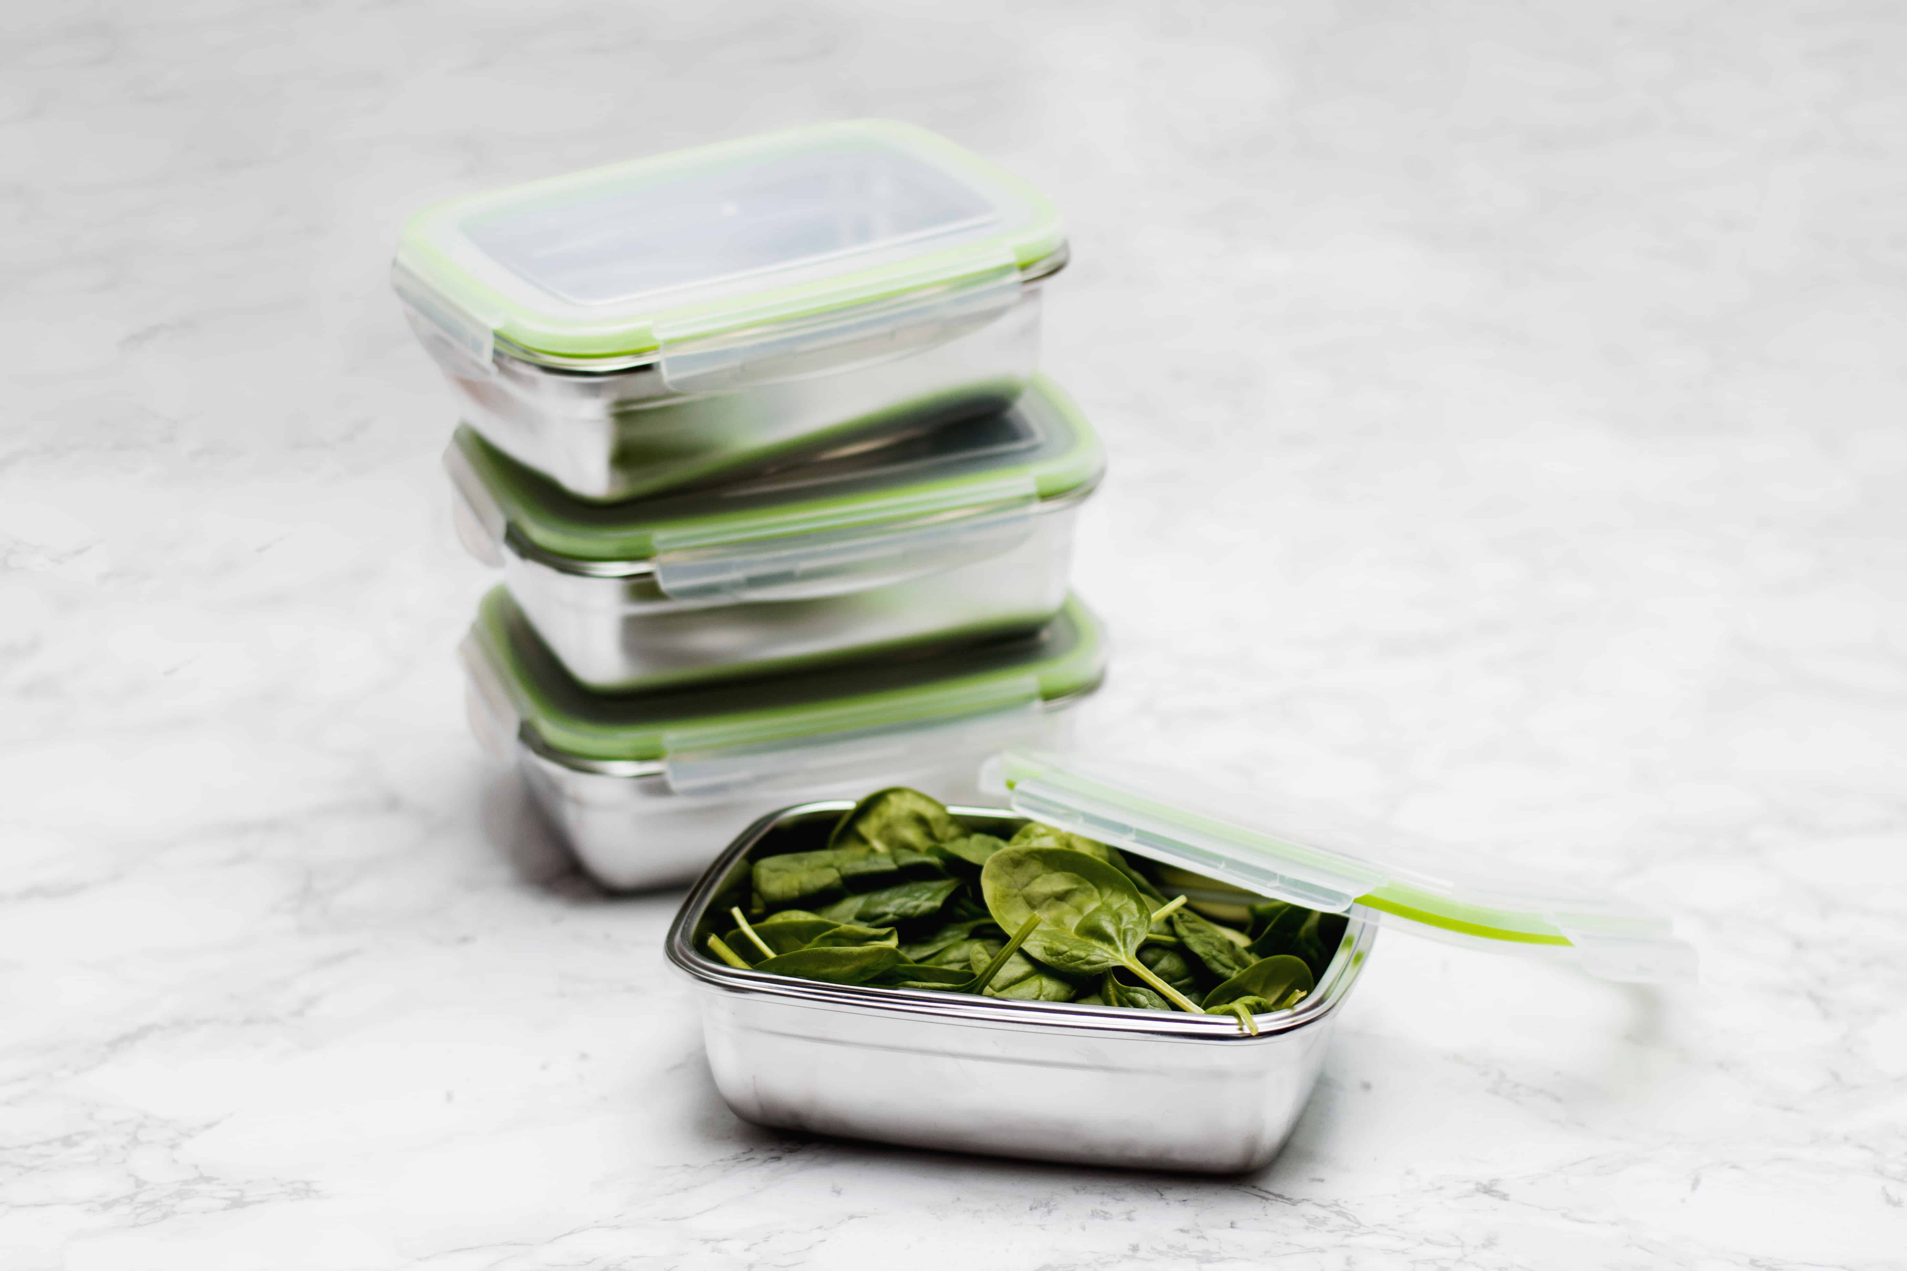

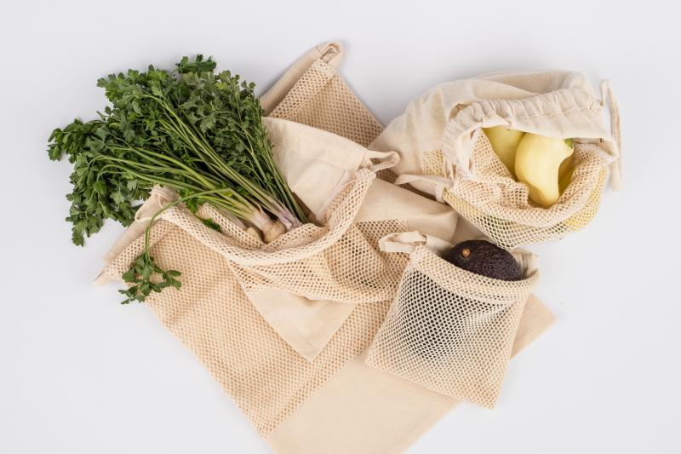
Good practices for using reusable packaging:
The customer takes the container home
The producer collects the packaging material
Special reusable food containers, e.g. RAKUN

Slide 32
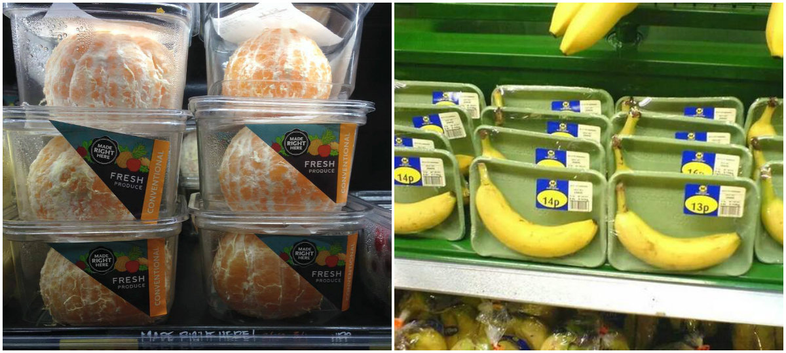
Let’s avoid unnecessary packaging!

Slide 33
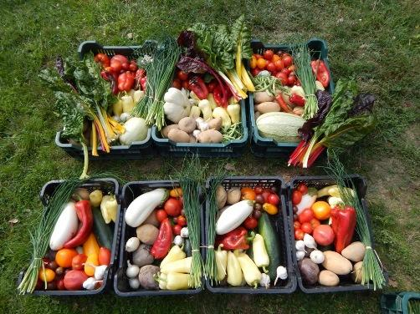
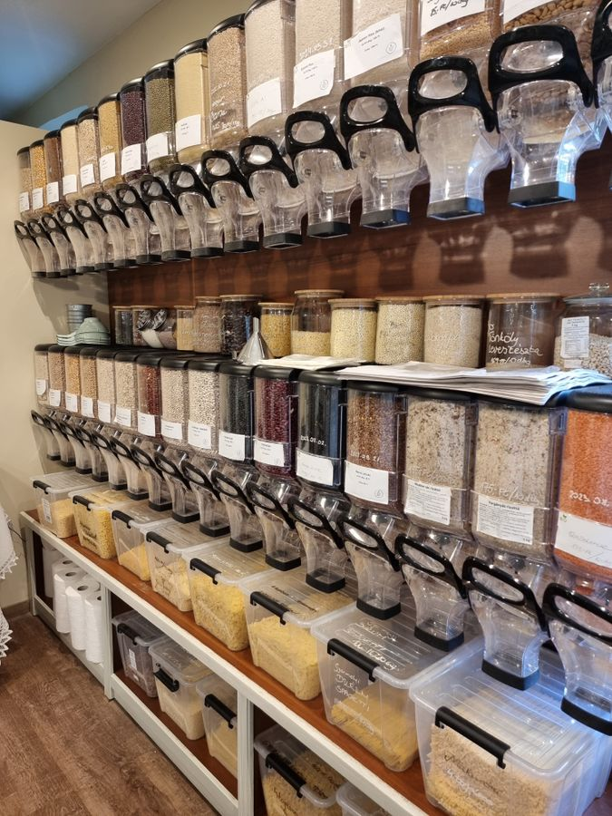
Packaging-free alternatives

Slide 34
Task:
When you buy a product (or use a service), where do you find out how sustainable that product (or service) is, and what sustainability criteria it meets?

Slide 35

4. Certification schemes
Organic certification – applies to the entire process!

Slide 36
Organic crop production
Avoiding artificial fertilisers and chemicals
Nutrient replenishment with organic matter
GMO-free
Soil protection
Water protection
Biodiversity
Crop rotation
Adaptation to local conditions
Organic livestock farming
Natural food,
our organic-certified
GMO-free feed
Free-range and
high animal welfare standards
Antibiotics may not be used routinely, only where justified
No use of hormones or chemicals
03.
Certification schemes

Slide 37





Basket Community Product Certification Scheme (TMR)
The “Basket Community” Product Rating System
Local property
Place of origin
of the raw material
Production method
Processing method
Waste generation
....... (depending on the place of sale)county
The main ingredient is locally sourced or produced on our own farm
Small biodynamic, organic, and eco-friendly farm
Handcrafted products that have undergone only basic processing and contain no additives
Without packaging or with reusable packaging(e.g., glass, egg carton)
5
Neighbouring counties
The main ingredients are sourced domestically
Small-scale farm (organic soil conservation and biological plant protection)
Freezing or heat treatment is used as a preservation method
Packaging that is necessary but made from renewable, biodegradable, and recyclable materials (e.g., paper, aluminum cans)
4
....... (depending on the place of sale) region
A small portion of the ingredients comes from external sources
Precision agriculture
Processed foods containing additives (e.g., flavour enhancers, texture enhancers)
Essential, but not recyclable (e.g., polystyrene)
3
Hungary
Most of the ingredients come from abroad
Conventional agriculture on an industrial scale
Additives outweigh the basic ingredients
Unnecessary packaging
2
abroad
Ingredients of foreign origin
The cultivation of genetically modified crops
This product also contains genetically modified ingredients
Packaging that uses composite materials (e.g., Tetra Pak) or that is not recyclable in its current form (e.g., polystyrene)
1

Slide 38
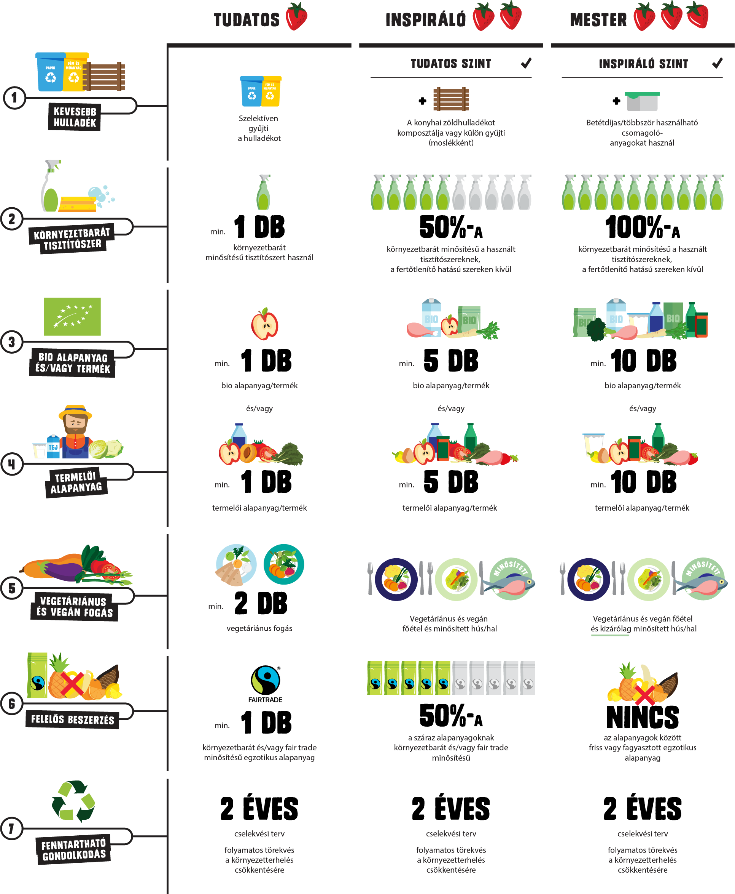
Responsible Gastrohero
Sustainable Restaurant
Certification Scheme

Slide 39
Imagine your sustainable future!

Slide 40
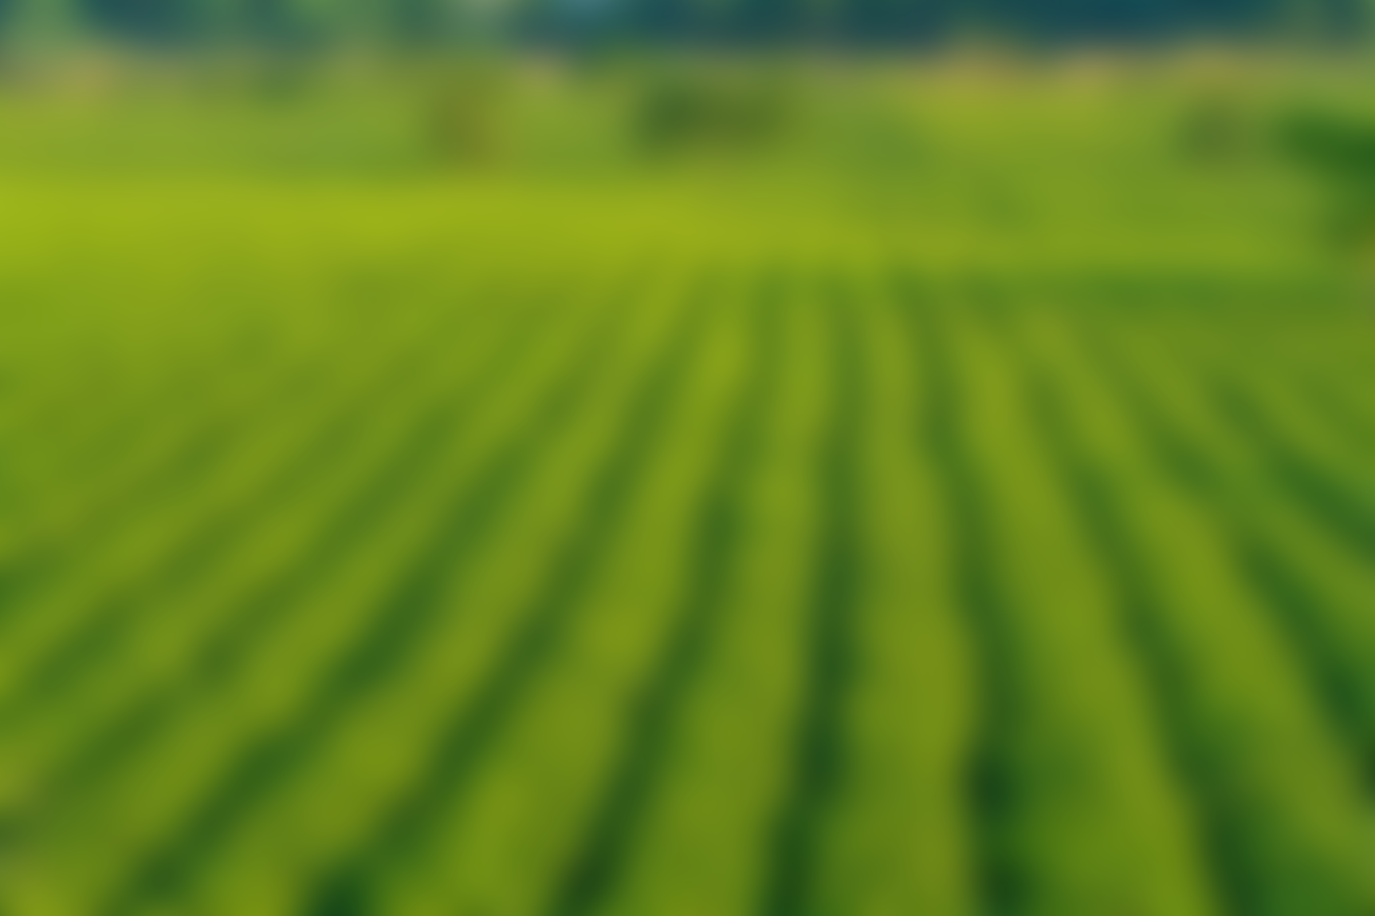
THANK YOU FOR YOUR ATTENTION!
Funded by the European Union. The views and statements expressed herein reflect the views of the author(s) and do not necessarily reflect the official position of the European Union or the Education, Audiovisual and Culture Executive Agency (EACEA). Neither the European Union nor the EACEA can be held responsible for them. Project number: 2024-1-RO01-KA210-ADU000254716

